Slide 1
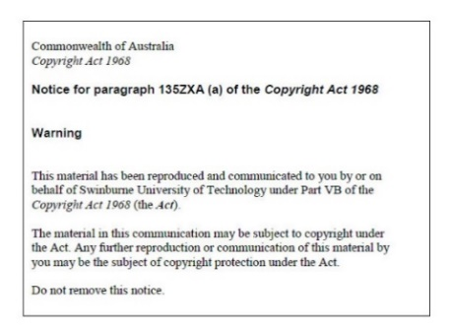
Lecture 10 – Part A
JavaScript Libraries, Frameworks and Web Servers
Armita Zarnegar
Check-In
Notes:
20410D
6: Implementing Dynamic Host Configuration Protocol

Slide 2
Overview
Common Libraries and Frameworks for JavaScript
Client Server Architecture
Website hosting
Windows server
Linux server
Cloud storage services
Roles in web development

Slide 3
Famous Libraries For JavaScript
React: a popular library for building user interfaces that is widely used by companies such as Facebook, Netflix, and Airbnb.
Node.js: a runtime environment for running JavaScript outside of the browser, allowing developers to build server-side applications using JavaScript.
jQuery UI: a set of user interface widgets and interactions built on top of the jQuery library that makes it easy to create rich and interactive web applications.

Slide 4
Famous Libraries For JavaScript
Angular: a powerful framework for building web applications that is backed by Google and offers a comprehensive set of features.
D3.js: a powerful data visualization library that makes it easy to create complex and interactive data visualizations using JavaScript.

Slide 5
React
ReactJS: known as React, this is the original version of React that was released by Facebook in 2013. React is a JavaScript library for creating dynamic and responsive user interfaces for web applications
React Native: This is a framework for creating cross-platform mobile apps on iOS, Android, and Windows with a native feel. It was also released by Facebook and uses the same concepts and syntax as ReactJS, but with additional APIs and components specifically designed for mobile development.
React VR: React VR is a version of React that is designed for building virtual reality applications. It allows developers to create interactive 3D environments using the same concepts and syntax as ReactJS.

Slide 6

React Native vs React
One of the advantages of React Native is its Performance. It is generally faster than ReactJS because it compiles down to native code that runs directly on the device, while ReactJS runs in a browser and is subject to the performance limitations of the browser.

Slide 7
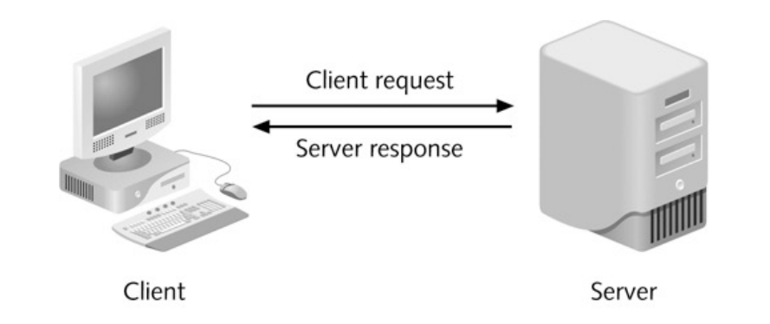
Client/Server Architecture- 2tier
You can have either two tier or three tier architecture. In two tier the server hosts the web server and client is ruing the web server and all other servers

Slide 8
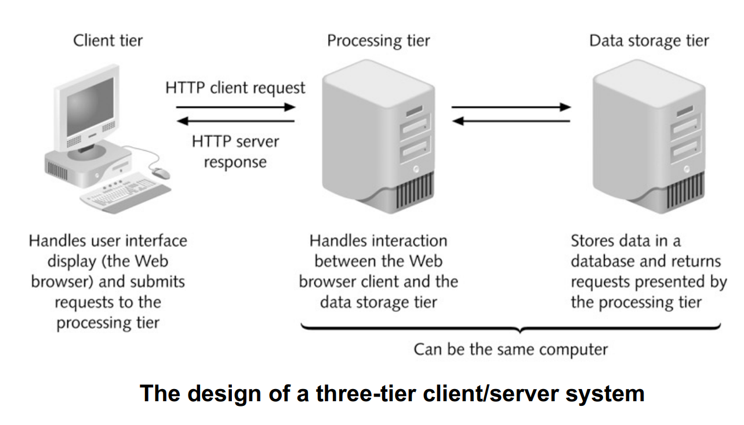
Client/Server Architecture-3tier

Slide 9

Web Site Hosting
After writing your web pages, you need a web server to host your website and make it accessible
The web server needs to have a valid IP address to host your website on the Internet
You also need a domain name for the website if you want people access your website by a name
There are many hosting providers, you need to consider which configuration you want to choose before choosing your hosting provider.
Usually Linux based hosting is cheaper than Windows one.

Slide 10
Web site hosting
IIS is the Windows web server
Apache is the Linux based web server (Mercury is an example of that)
You can also host your static websites on cloud storage spaces such as AWS, S3 bucket or Azure Storage
When you host your static websites on a cloud storage you do not need to install and deal with web servers as the cloud provider manage that for you automatically

Slide 11
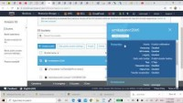
Hosting a static website on AWS

Slide 12
Website Hosting
Once you installed a web server, you can access the main page (index page) of your web site by typing the URL or IP address of your web server on a browser.
A web server can host multiple websites at the same time. To do that you need to use domain name and can be done either using subdomains, virtual hosting.

Slide 13
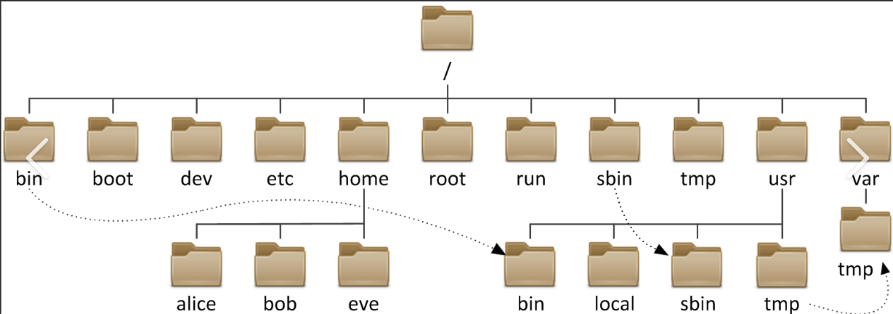
Linux Directory Structure and Apache
In Mercury you put your HTML files in your Home directory
On a typical Linux server usually Apache folder is under etc director
.

Slide 14
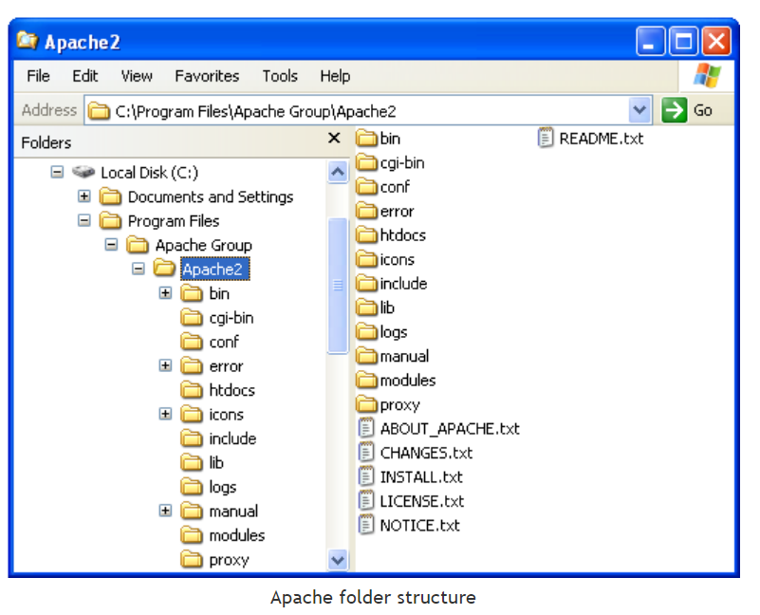
Apache Folder Structure
Htdocs: This folder contains the default HTML page you see when you visit http://localhost/ with your web browser.
Logs : This folder contains (amongst others) the access.log and error.log files.

Slide 15
Folders in Apache
bin folder: it contains files such as the server executable: Apache.exe. It also contain a program to control the Apache HTTP server when ran as service
config folder: holds the configuration files used by the Apache web server. Of each file used by the server there is a copy which has .default in its name, e.g. httpd.default.conf. The httpd.conf file has already been updated by the installation process. Below is the list of modified settings:
Listen 80 - The port the Apache server is using. If you have already a web server running, for example as part of Microsoft Internet Information Services (IIS), you might want to change the number to something different.
ServerAdmin admin@localhost - The email address of the server administrator, which is used on, for example, error pages generated by the server.
ServerName localhost:80 - The hostname and port the server uses.

Slide 16
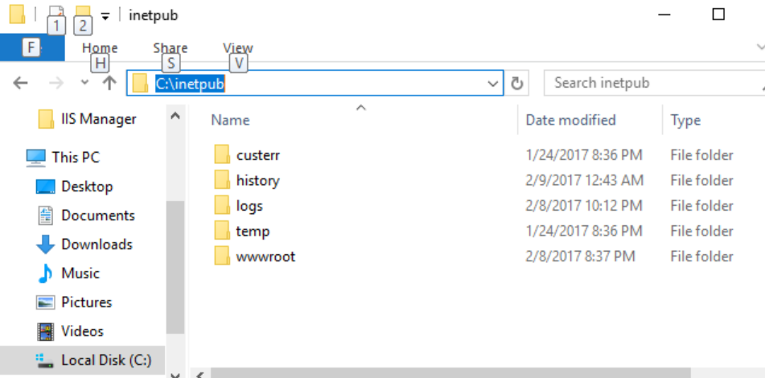
IIS Web server
This URL goes through the configuration of IIS in details:
How To Configure Default Site in IIS Server 2019 | ComputingForGeeks How to use Default Site in Windows IIS webserver

Slide 17
Web Development Roles
Front end developer: works on the client side and how the websites look. Skills: HTML, CSS and JavasScript
Back end developer: works on server-side software, which focuses on everything you can’t see on a website. Skills: NodeJS, Python, Ruby
Full stack developer: it does both. Recently, there are more demands for full stack developers.

Slide 18
Wake brain
You have written some web pages and put images into a directory structure. You copy your code and images all into htdocs document of your Apache webserver. You can access the HTML pages but can not see the images. What is wrong?
You need to configure your Apache so you can read images
You need to create the same folder structure that you had while developing the code on the web server
You need to change the path in your web pages to point to images as you changed the directory structure
There is a bug in your Apache installation
Notes:
B is correct

Slide 19
Wake brain
Which of the following is NOT a skill for a backend developer?
Python
React
Ruby on Rails
PHP
Notes:
c

